Slide 1
CS443 Library Db wEBSITE
Cy Dixon & Nicholas Johnson

Slide 2
Project Overview
Online Library Checkout and Inventory System
Utilizes a Database to store library books
Has 3 relations
Is in 3NF
Allows for Admin & User Functionality
Users can check out and see available books
Admins can add and manage existing books

Slide 3
Project Tools
Python
Django Web Framework
SQLite
Built in DB used by Django
HTML
Used to structure the webpages
GitHub
Used for project version control

Slide 4
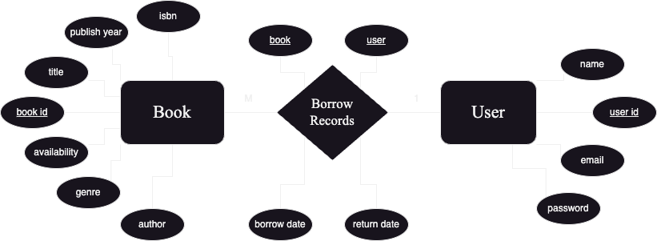
Project ER Diagram

Slide 5
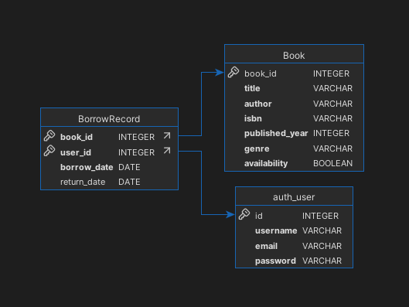
Project Relational Database Schema

Slide 6
Key interfaces
Insert: Books into the database
Delete: Books from the database
Update: Books and Users already in the database
Query: Search for books in the database

Slide 7
Challenges
Getting the database in 3rd normal form
Correct implementation of schema to website

Slide 8
Demo
Best Database Website Ever to Grace the Web

Slide 9
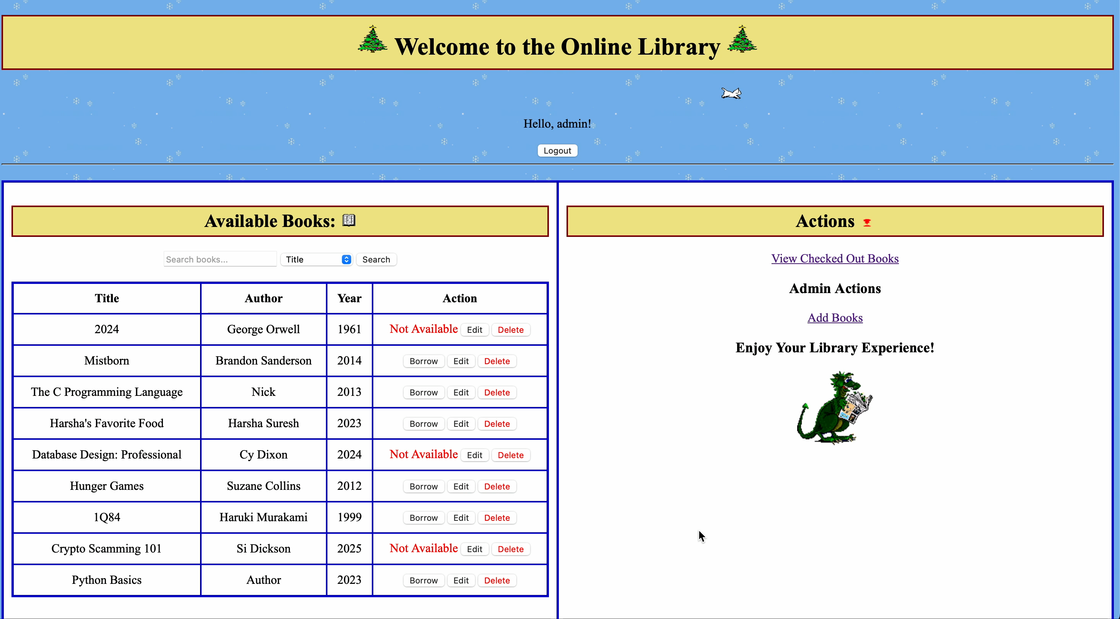
Backup demo

